Slide 4
Moses
Exodus 1-3

Slide 5
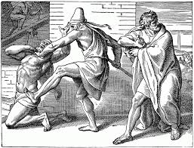

Slide 6
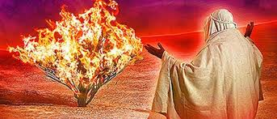

Slide 7
Naomi
Ruth 1-4

Slide 8
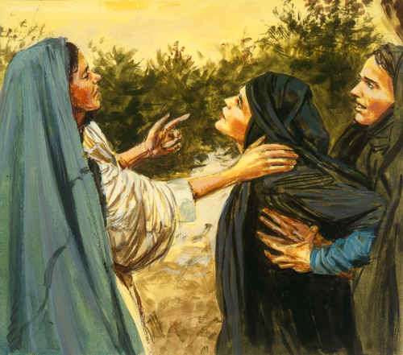

Slide 9
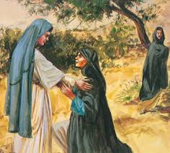

Slide 10
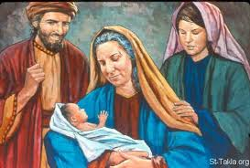

Slide 11
David
2 Samuel 11-12:14
Psalm 51

Slide 12
Psalm 51
1 Have mercy on me, O God, according to your unfailing love;
according to your great compassion blot out my transgressions.
2 Wash away all my iniquity and cleanse me from my sin.
3 For I know my transgressions, and my sin is always before me.
4 Against you, you only, have I sinned and done what is evil in your sight,
so that you are proved right when you speak and justified when you judge.
5 Surely I was sinful at birth, sinful from the time my mother conceived me.

Slide 13
⁶ Surely you desire truth in the inner parts;
you teach me wisdom in the inmost place.
7 Cleanse me with hyssop, and I shall be clean;
wash me, and I shall be whiter than snow.
8 Let me hear joy and gladness;
let the bones you have crushed rejoice.
^{9 Hide your face from my sins}
^{and blot out all my iniquity.}

Slide 14
10 Create in me a pure heart, O God, and renew a steadfast spirit within me.
11 Do not cast me from your presence
or take your Holy Spirit from me.
12 Restore to me the joy of your salvation
and grant me a willing spirit, to sustain me.

Slide 15
13 Then I will teach transgressors your ways,
and sinners will turn back to you.
14 Save me from bloodguilt, O God,
^{the God who saves me,}
and my tongue will sing of your righteousness.
^{15 O Lord, open my lips,}
and my mouth will declare your praise.

Slide 16
16 You do not delight in sacrifice, or I would bring it;
you do not take pleasure in burnt offerings.
17 The sacrifices of God are a broken spirit;
^{a broken and contrite heart,}
^{O God, you will not despise.}

Slide 17
Peter
Matthew 26:31-35, Luke 22:54-62, John 21:15-19

Slide 18
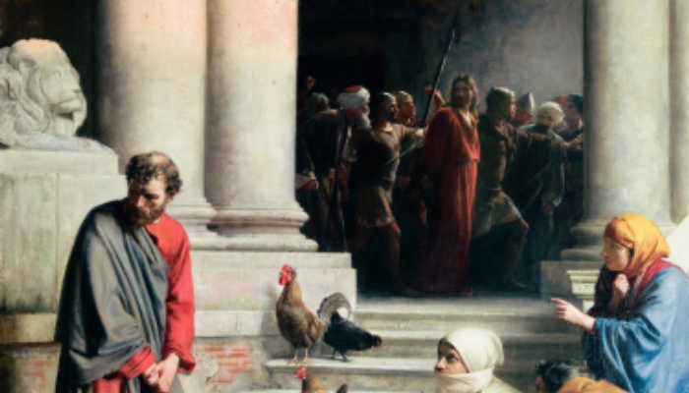

Slide 19
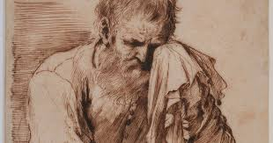

Slide 20
